Slide 1
Disasters, Continuity, and IT
Keeping your business afloat during the storm.
Project Team: Charles A. Hulebak, Will Bobe, Alivia Coon, Edward Kim

Slide 2
TABLE OF CONTENTS
02
04
06
08
Risks
BIA
IT Projects
Conclusion
01
03
05
07
Introduction
Cost
BIA Team
Recap

Slide 3
01: Introduction
Cocoa-Sassafras Corporation (CSC) background and future initiatives.

Slide 4
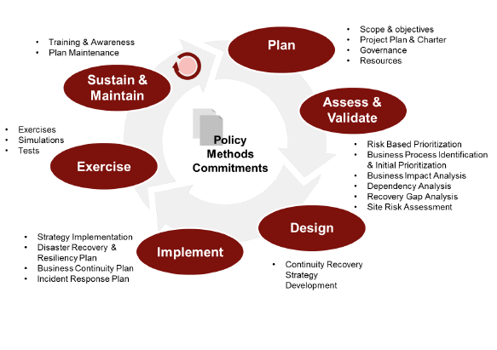
Business Continuity and Disaster Recovery
Cocoa-Sassafras Corporation (CSC) is a US-based food and beverage company with manufacturing, distribution, and data centers in the US, Canada, and Mexico. CSC recently acquired Snack World, Inc. (SW) two years ago, and reported $3 billion in revenue last year.
CSC has experienced interruptions to business operations associated with previous natural disasters and is eager to prepare for future risks. CSC’s leadership conducted a Business Continuity Plan (BCP) and Disaster Recovery (DR) Plan three years ago, however the business leaders are seeking to integrate a new plan for both current and future concerns.
The program lifecycle shown in figure 1 has been established to guide the leadership of CSC into the future. As part of this initiative, the BCP leadership team will focus on the Planning, as well as Assess & Validate stages toward future implementations.
Figure 1: CSC’s BC-DR Program Lifecycle Plan
References:
https://docs.intersystems.com/irislatest/csp/docbook/DocBook.UI.Page.cls?KEY=GHA_mirror_set_comm_network_dual
https://www.thorntech.com/2017/05/cloud-disaster-recovery/

Slide 5
02: Risks
What’s coming? Considering natural, human, and environmental risks.

Slide 6

Disasters
Hurricane Sandy
Disasters come in many forms, and may include:
Natural disasters, Accidents, Sabotage, Power & Energy Disruption, Communications/Transport/Security failures, Terrorist attacks, Pandemics, Environmental Disasters, Pollution, Hazardous Material Spills, Cyberattacks and Hacker activity.
Sandy was one of the top five most destructive hurricanes that hit the United States. This hurricane significantly affected CSC’s major distribution and data centers in the north east, prompting CSC to re-evaluate its Business Continuity (BC) and Disaster Recovery (DR) preparedness business-wide.

Slide 7
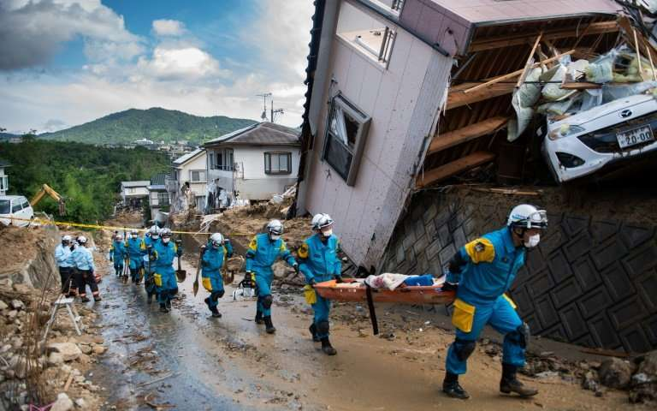
Losses
Losses can come in various forms: People, Facilities and Equipment, Communications, Supplies, Information and IT Systems.
The cost to CSC from the loss of critical personnel or data infrastructure could be immense.

Slide 8

CSC’s Particular IT Vulnerabilities
CSC currently has two data centers, (1) in Illinois, and (2) in Philadelphia. They have a myriad of issues:
Philadelphia, the site most recently struck by Hurricane Sandy, is the primary recovery site for the Illinois Data Center, but not vice versa. “no plan in place to be able to recover the JD Edwards ERP system.” Migration from one ERP system to another will take at least 1 year.
The maximum acceptable recovery time for the SAP system is 14 days, but no testing has been done. We have no idea how long it will take.
Two ERP systems are currently in use. CSC uses SAP, and SW uses JD Edwards.
Resiliency is a major concern for the business continuity of CSC.

Slide 9
03: Costs
The financial impact associated with protecting critical business systems.

Slide 10

Categories of Cost
The Costs of a disaster are manifold, and fall into the following general categories.
Enterprise Resource Planning (ERP) Software down time.
Legal ramifications of contract breaches.
Damage to Brand Image.
Personal injury liabilities to Personnel.
Clearing, Repairing, Replacing, Refitting, and Reinstalling equipment and facilities.
A previous BIA identified procurement, manufacturing, and distribution process as the primary source of revenue and therefore most vulnerable section of CSC. The following cost analysis will focus on IT in this specific context.

Slide 11
ERP Downtime calculations
Based on outdated BIA, 5 days without SAP would result in a 10% loss in revenue.
Net sales for the current year is $4,135,801,000. (Probably high due to merger)
Net sales for last year was $2,853,238,000. (approx. 300 million loss)
Net sales for 2 years ago was $2,690,361,000. (approx. 250 million loss)
Considering the yearly income hovers around 100 million, a five day downtime would wipe out multiple years worth of income.
Obviously, this necessitates a hot alternate facilities that can handle simultaneous transfers of load from sister facilities, or another creative solution.

Slide 12
04: Contingency Planning & the New Business Impact Assessment
Developing a comprehensive and sustainable plan built upon dependable framework.

Slide 13

Business Continuity & Disaster Recovery Program Lifecycle
Plan
Design
Assess & Validate
Implement
Exercise
Sustain & Maintain
Each of our projects fits into CSC’s BC-DR Program Lifecycle:
Plan
Assess & Validate
Design
Implement
Exercise; and
Maintain
Scope & objectives, Project Plan & Charter, Governance, Resources
Continuity Recovery Strategy Development
Prioritization and Analysis: specifically Business Impact Analysis
Executing the strategy, and plans.
Exercises, Simulations, Tests.
Training & Awareness, Plan Maintenance.

Slide 14
Business Impact Analysis (BIA) Approach
As part of the Assess and Validate stage of CSC’s BC-DR Program Lifecycle, the leadership team is seeking to utilize the NIST 800-34r1 Contingency Planning Guide for Information Technology Systems.
This framework addresses the concerns for CSC’s mission and business processes, while focused on the Confidentiality, Integrity, and Availability of organizational assets and systems.
The seven steps within NIST’s Contingency Planning Process framework include:
Develop the contingency planning policy;
Conduct the Business Impact Analysis (BIA)
Identify preventive controls;
Create contingency strategies;
Develop an information system contingency plan;
Ensure plan testing, training, and exercises; and
Ensure plan maintenance.
Within the BIA phase, the three critical steps to accomplish the BIA include: 1) Determine mission/business process and recovery criticality; 2) Identify resource requirements; and 3) Identify recovery priorities for system resources.

Slide 15
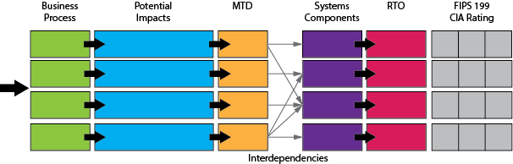
Business Impact Analysis (BIA) Methodology
CSC’s BIA Leadership team is seeking to obtain input from key stakeholders and collect quantifiable data to inform decision-making processes. This information will help CSC identify and prioritize business risks in alignment with the impact on processes if these systems were unavailable.
Rating factors include:
Determine criticality of systems
E.g., the maximum outage tolerance for each system
Include outage impacts (Severe/Moderate/Minimal)
Determine downtime expectations (Maximum Tolerable Downtime (MTD), Recovery Time Objective (RTO), and Recovery Point Objectives (RPO))
Determine costs for downtime
Resource: NIST SP800-34r1 (3.2 & Appendix B)

Slide 16
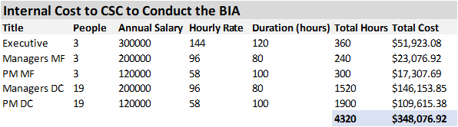
BIA Costs
The CSC business continuity plan provides the ability to avoid a potential infrastructure failure, which can cost USD $100,000 an hour and a critical application failure can cost USD $500,000 to USD $1 million per hour.
CSC has invested nearly $350,000 to conduct the BIA, allocating financial resources to the leadership team, management and project managers from each manufacturing facility and distribution center. CSC is anticipating approximately three months to conduct the BIA, with various amounts of participation from team members.
This is a small price to pay for business continuity!
References:
https://www.ibm.com/services/business-continuity/plan
https://www.continuitycompliance.org/tools-resources/community-projects/business-impact-analysis/estimating-the-cost-of-a-business-impact-analysis/ (For the calculation of the cost of the BIA)
https://www.accountingweb.com/practice/practice-excellence/survey-public-and-private-company-audit-fees-went-up-in-2013 (For the typical hours to audit a private company)

Slide 17
05: The BIA Team
The CSC BIA leadership team steps into action.

Slide 18
CSC’S BCP TEAM
The key stakeholders within CSC that will be involved with the BCP include:
John Smalling, Chief Risk Officer
Responsible for the overall direction, decision-making, and approvals
Katie Pena, Business Continuity Director
Responsible for activating the BCP and providing emergency notification
James Miller, Disaster Recovery Manager
Responsible for assessing the damage and coordinating salvage options
Managers from Manufacturing Plants
Responsible for faculty and the security of the sites
Divisional Management from Distribution Center Regions
Responsible for overseeing delivery to and from sites

Slide 19
OUR TEAM
BCP Leadership
John Smalling
James Miller
Katie Pena
Manufacturing Plants
Manufacturing Plants
Manufacturing Plants
Distribution Facilities
Distribution Facilities
Distribution Facilities
Distribution Facilities
Distribution Facilities
Distribution Facilities
Chief Risk Officer
Disaster Recovery Manager
Business Continuity Director

Slide 20
06: IT Projects
Solutions.

Slide 21
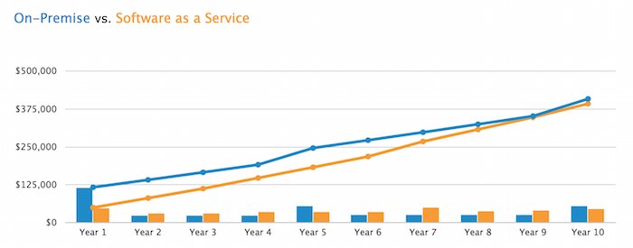
Mirroring, Mutual Recovery, & Integrating ERPs
Continue the plan to integrate the data centers and move toward one ERP while beginning a phased process of migrating from on-premise to hybrid cloud based options
Implementing a new ERP can cost up to $10m plus annual costs for maintenance and upgrades which are included in Cloud platform costs (Better Buys)
Cloud costs range and can be a flat rate or a rate per user (e.g., Lilly works is $100 per user per month versus $12,149 per month for all of the features included in the SAP from SAP Cloud Platform store)
Assessment and migration of the current SAP and ERP will take 12 months to complete, moving toward a Cloud solution save time and provide more stability sooner, with some features spinning up instantly
Migration to the hybrid approach should be incremental anyway and hybrid provides stability, cost savings, and scalability increases while also allowing more flexibility and power over data
Savings for moving ERP to the cloud may eventually converge
Easy to set up in the cloud
Less hardware & any further mergers could be more seamlessly handled
Interoperability and access of ERPs within the cloud
Make sure you: TEST TEST TEST

Slide 22
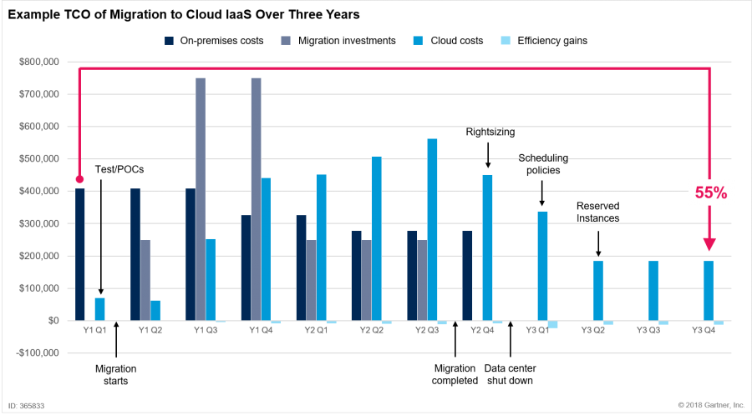
Increasing Resiliency: Cloud benefits
Eventually move to Cloud web server failover approach in real time
Cost-effective - economy of scale, externally managed, low maintenance overhead
After three years there may be a 55% cost savings by moving to cloud (Gartner)
With average costs of running a typical data center being $18.5m (US Chamber of Commerce), this could save $8.325m annually
Fault tolerance
Up to 94% application downtime reduction (AWS)
Scalable
Grows with the business instantly and without additional costs for hardware and support
No Colocation Issues - no sharing of physical space with the server and no costs for the space the data centers will use
Availability zones
run critical applications with higher availability and fault tolerance to data center failures

Slide 23
07: Quick Recap of Costs and Benefits
For your cost benefit analysis.

Slide 24
BIA
Costs $ 350 thousand.
2. Mirroring Project
Costs 10 million one time.
3. Cloud
Saves 8.325 million annually.
Benefit: Updates information and increases accuracy of measurements.
Benefit: decreases likelihood of possible 300 million dollar loss.
Benefit: decreases likelihood of possible 300 million dollar loss.

Slide 25
08: Conclusion
Wrapping up.

Slide 26
The Bottomline
Our solutions provide a way to assess the human, natural, and environmental risks and seek to maintain CSC's objectives
Keep employees safe
Keeping CSC products available and on the shelf
Keep critical supplier, employee and client data secure
The BIA utilizes NIST 800-34r1 Contingency Planning Guide for Information Technology Systems
We suggest to integrate the data centers and adapt to one ERP
Phased process of migrating from on-premise to hybrid cloud based options
The cloud offers cost-effective benefits with low maintenance overhead
Implementation to be complete within 12 months

Slide 27
In Summary
The three new projects outlined above will (1) give us a perfect view of the various impacts and vulnerabilities throughout the business by implementing a new BIA, (2) harden our existing data centers to make them mutually supporting superfortresses, and (3) move our systems to the cloud to further improve resiliency.
The current state of affairs is unacceptable, and expose the business to critical risk, allowing a single bad storm to potentially bankrupt CSC. The above BCM and DR projects will not only improve resiliency but save money, and make sure your business keeps on keeping on through the worst of the storms.

Slide 28
References:
“Mirroring configurations for dual data centers and geographically separated disaster recovery: High availability guide: Intersystems iris data platform 2022.1,” Mirroring Configurations For Dual Data Centers and Geographically Separated Disaster Recovery. [Online]. Available: https://docs.intersystems.com/irislatest/csp/docbook/DocBook.UI.Page.cls?KEY=GHA_mirror_set_comm_network_dual.
T. T. Staff, “How to Improve Your Disaster Recovery Plan with the Cloud,” Thorn Technologies, 23-May-2022. [Online]. Available: https://thorntech.com/cloud-disaster-recovery/.
Höllwarth Tobias, “Cloud migration,” Amazon: Cloud migration, 2012. [Online]. Available: https://aws.amazon.com/cloud-migration/. [Accessed: 08-Oct-2022]
“Cloud Migration,” IBM: Cloud-migration. [Online]. Available: https://www.ibm.com/cloud/learn/cloud-migration#toc-costs-and--jLe6bq6n.
M. Meinardi, Is Public Cloud Cheaper Than Running Your Own Data Center?, 28-Oct-2020. [Online]. Available: https://blogs.gartner.com/marco-meinardi/2018/11/30/public-cloud-cheaper-than-running-your-data-center/. [Accessed: 08-Oct-2022]
IBM Cloud Pricing. [Online]. Available: https://www.ibm.com/cloud/pricing.
R. A. Caralli, J. F. Stevens, L. R. Young, and W. R. Wilson, “Introducing Octave Allegro: Improving the Information Security Risk Assessment Process,” Introducing OCTAVE Allegro: Improving the Information Security Risk Assessment Process, 01-May-2007. [Online]. Available: http://www.cert.org/octave/.
D. E. Andres , “Methodologies to implement ERP systems - Project Management Institute,” Methodologies to implement ERP systems are they PMBOK guide compliant?, Oct-2006. [Online]. Available: https://www.pmi.org/learning/library/methodologies-erp-systems-pmbok-8166.
Z. Hale and T. Cox, “Cloud ERP vs. on-premise ERP: Which one is right for you?: Software advice,” Cloud ERP vs. On-Premise ERP, 24-May-2022. [Online]. Available: https://www.softwareadvice.com/resources/cloud-erp-vs-on-premise/.
N. Pham, “Heat sensing drones deployed after natural disasters to locate,” Landscape of the Data Center Industry, 01-May-2017. [Online]. Available: https://www.uschamber.com/assets/archived/images/ctec_datacenterrpt_lowres.pdf.
How Much Does an ERP System Cost? 2022 Pricing Guide, 02-Dec-2021. [Online]. Available: https://www.betterbuys.com/erp/erp-pricing-guide/.
“Integration and data management: Technology Tools and services,” Integration. [Online]. Available: https://www.sap.com/products/cloud-platform/pricing.html.

